Slide 1
Concept of disaster
A disaster is a serious disruption occurring over a short or long period of time that causes widespread human, material, economic or environmental loss which exceeds the ability of the affected community or society to cope using its own resources.
Disasters are of following types: Natural, Man made and Hybrid.
Natural Disaster:
A natural disaster is a natural process or phenomenon that may cause loss of life, injury or other health impacts, property damage, loss of livelihoods and services, social and economic disruption, or environmental damage.
Eg: Earthquakes, Landslides ,Volcanic eruptions, floods, hurricanes, tornadoes, blizzards, tsunamis, cyclones and pandemics.
Man made disaster
Man made disasters are the consequence of technological or human hazards.
Examples include fires, transport accidents, industrial accidents, Oil spills, terrorist attack, nuclear explosions, war etc.
Hybrid disaster
It occurs when anthropogenic (man made) activities increase more damage from natural disasters.
Eg: Flood takes place after humans have destroyed or cut forest.

Slide 2
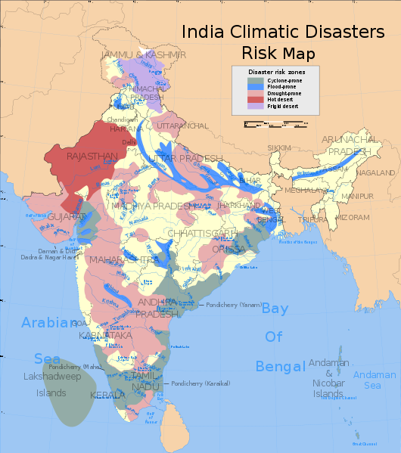

Slide 3
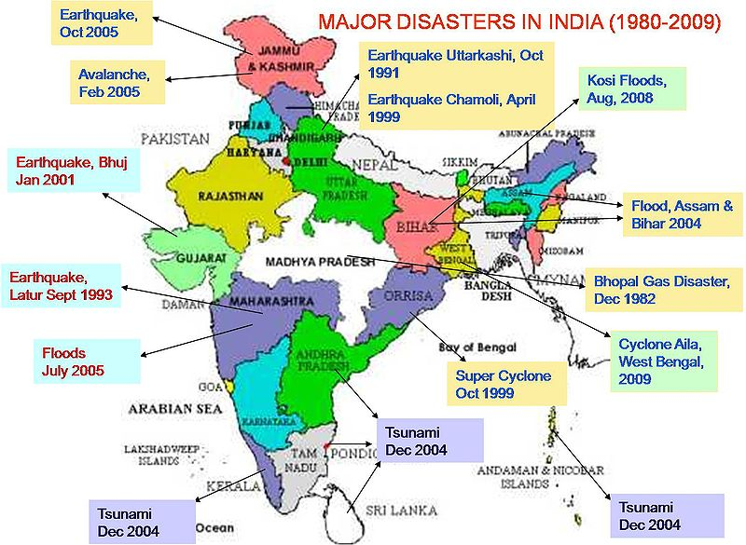

Slide 4
Effects of disaster
Every year millions of people are affected by man made and natural disasters. Physical and economic losses occur. The effects in brief are as follows:
Physical effects:
Death- Disasters such as earthquakes, floods etc, result in death of several people. Over 10000 people died in Tsunami in India in tsunami. 5 lakh people lost their lives in cyclone in West Bengal in 1970.
Physical injury- Several people get injured in various disasters. It results in mental agony and trauma on the victims. Sometimes injuries are life long. Eg: Gujarat earthquake killed about 1.7 lakh people in 2001.
Outbreak of diseases- Disasters like floods, cyclone lead to pollution of water which leads to water borne diseases. Transmission occurs through skin, mucous membrane coming in contact with water, mud and damp vegetation.
Overcrowding in relief camps gives rise to communicable diseases. People become vulnerable to vector borne diseases which are transmitted by insect, animal bites, mosquitoes. Lack of nutrition due to loss of agriculture leads to decline in health of people.

Slide 5
Psychological effects:
There are mental health effects of disasters. Emotional distress can be observed after disasters whenever there is a heavy loss. Disasters like floods, earthquakes lead to huge losses. Fear and anxiety spreads like a famine. Acute shortage of supplies may take place. Post traumatic stress disorders are observed after various disasters.
Stress related symptoms may be observed such as headaches, blood pressure, ulcers, digestive problems, depression, sleep disorders, nervousness.
Behavioral symptoms include aggression, performance problems, excessive smoking, nervousness, emotional instability etc.
Fear, anxiety, physical complaints, sleep disorders and other stress disorders are common if somebody has got exposed to disaster directly.
Compensation and rehabilitation packages, claims for death and damages get delayed during and even post disaster. This aggravates the trauma of the victims.
Loss of property, displacement gives rise to negative psychological effects on account of disasters.

Slide 6
Economic Effects:
Unemployment- People get unemployed due to destruction of infrastructure, damage to factories, fields, vehicles or sometimes due to physical injuries which make individual unable to work.
Loss of Assets- Disasters like earthquakes, tsunami result in loss of property. Disasters also loose valuables such as gold, cash and other assets.
Economic loss due to loss of assets- Disasters like earthquake, tsunami, cyclone, floods result in loss of property , which may be difficult to recover. Loss of other valuable may also occur. Soil looses its fertility due to deposition of various materials carried away by various disasters.
Loss due to injury- The government compensation may be limited many times. Lots of money is spent on recovery of injury. Loss may also occur due to death of earning family members.
Social Effects:
Caste and Communal discrimination- In the post disaster period, survivors face caste and communal discrimination. Compensation packages announced by government were distributed discriminately.
Problem of social networking- Many of the people loose their relatives, friends, work mates because of death caused by disasters. It may induce stress related symptoms.
Social Evils- Post disaster effects result in social evils such as robberies, murders etc. It becomes difficult to get employment in the short term. There are various cases of increase in gambling after disaster.

Slide 7
BHUJ EARTHQUAKE
The 2001 Gujarat earthquake, also known as the Bhuj earthquake, occurred on 26 January, India's 52nd Republic Day at 08:46 am IST.
Effects:
Various villages were flattened and deaths occurred.
Over one million structures were damaged or destroyed, including many historic buildings and tourist attractions.
The quake destroyed around 40% of homes, eight schools, two hospitals and 4 km of road in Bhuj, and partly destroyed the city's historic monuments. 40 percent of hostoric places were damaged and collapsed.
In Ahmadabad, (Gujarat's commercial capital ) as many as 50 multi-storey buildings collapsed and several hundred people were killed.
Total property damage was estimated at $7.5 billion. In Kutch, the earthquake destroyed about 60% of food and water supplies and around 258,000 houses, 90% of the district's housing stock.
The biggest setback was the total demolition of the Bhuj Civil hospital.
The Indian Military provided emergency support

Slide 8
Relief:
Four months after the earthquake the Gujarat Government announced the Gujarat Earthquake Reconstruction and Rehabilitation Policy.
The main objectives of the policy included repairing, building, and strengthening houses and public buildings. Other objectives included the revival of the economy, health support, and reconstruction of the community and social infrastructure.
In order to support the reconstruction and rehabilitation of the city, the Gujarat government created four assistance packages worth up to US$1 billion. These packages assisted about 300,000 families. The government also announced a US$2.5 million package to revive small, medium, and cottage industries. The World Bank and the Asian Development Bank also provided loans worth $300 million and $500 million respectively.

Slide 9
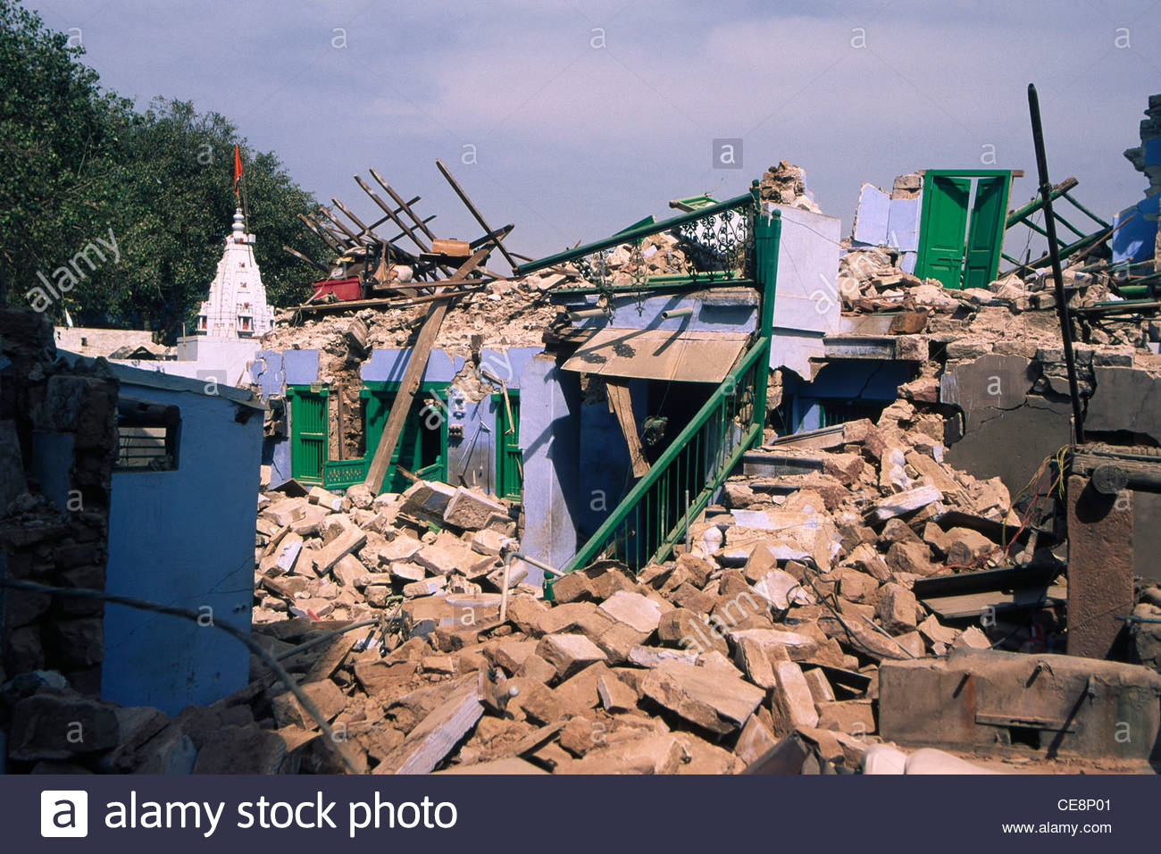

Slide 10
MAHARASHTRA FLOODS 2005
The 2005 Maharashtra floods was a major event which has destroyed many parts of state including Mumbai. At least 5000 people died. It occurred on 26th July 2005.
The floods were caused by the 8th heaviest ever recorded 24 hours rainfall of 994 mm. and continued for the next day. The government of Maharashtra declared 27th and 28th July as state holiday for the affected regions.
Other places which were severely affected were Raigad, Chiplun, Khed,Ratnagiri and Kalyan in Maharashtra and Goa.
During the disaster, lakhs of people were stranded on the road, railway platform. Many walked for a long distances.
Effects:
Local train movements were halted due to water logging on the tracks. Flight operations were shut for more than 30 hours.
Water logging and submergence occurred in Dharavi, Bandra- Kurla complex, Chunabhatti, Chembur, Ghatkopar, Milan subway, Sion etc.
Cellphone networks went down . Landline and MTNL were partially functional. Radio stations and television channels did not receive any warnings or alerts by civic agencies.

Slide 11
Rescue and Relief measures:
The entire government machinery along with local offices of Municipal Corporations got into action.
Arrangement for self evacuation was done through boats and buses.
Public schools and transit shelters were arranged for sheltering of people.
Community kitchens were started by govt. of Maharashtra and Municipal Corporations as well as by NGOs for providing free food grains.
The traffic police and fire brigade played important role in clearing traffic.
Best provided extra services for various routes.
Emergency relief arrangements were organized on a war footing. Food packets and drinking water was arranged.

Slide 12
Areas in Mumbai badly affected by the flooding

Slide 13
OIL SPILL- COLLISION OF MSC CHITRA AND MV KHALIJIA
Two cargo ships collided off the Mumbai coast on August 7 causing an oil spill that spread quickly through Maharashtra's coastline.
MSC Chitra ruptured its tank when it hit incoming MV Khalijia and ran aground at Colaba, near Prongs Reef Lighthouse.
The vessel contained about 1,200 tonnes of fuel oil in its tanks of which 800 tonnes spilled into the Arabian Sea before the leaks could be plugged two days later.
The collision damaged Khalijia's prows. Chitra tilted precariously at a 75o angle which caused 400 containers on its deck to fall off and float in the sea. Some of these containers had toxic organophosphate pesticides.(https://www.downtoearth.org.in/news/mumbai-oil-spill-threat-to-marine-life-coast--1841)
Effects:
Nearly 800 tonnes of oil was leaked into the Arabian sea and was floating close to the coastline threatening marine life.
Coast Guard have sprayed anti dispersants to prevent the oil spill from spreading.
The oil spill was spread over an area of 25 suare kilometers and hazardous chemicals and pesticides could affect 200 species of marine life.
Mangroves off Navi Mumbai were destroyed.

Slide 14
The Bhabha Atomic Research Centre has been advised not to use sea water to cool its reactors as it might contain oil and toxic substances.
The BMC also advised people against eating sea fish for some period as a precaution.

Slide 15
Types of disasters
1
Natural
2
Hybrid
3
Man made

Slide 16
Natural disasters

Slide 17
earthquake
An earthquake (also known as a quake, tremor or temblor) is the shaking of the surface of the Earth resulting from a sudden release of energy in the earth’s lithosphere that creates seismic waves. Earthquakes can range in size from those that are so weak that they cannot be felt to those violent enough to propel objects and people into the air, and wreak destruction across entire cities. The seismicity, or seismic activity, of an area is the frequency, type, and size of earthquakes experienced over a period of time.
Causes:
Volcanic activity
Landslides
Mine blasts
Nuclear tests

Slide 18
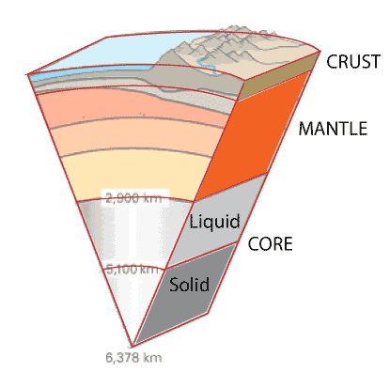
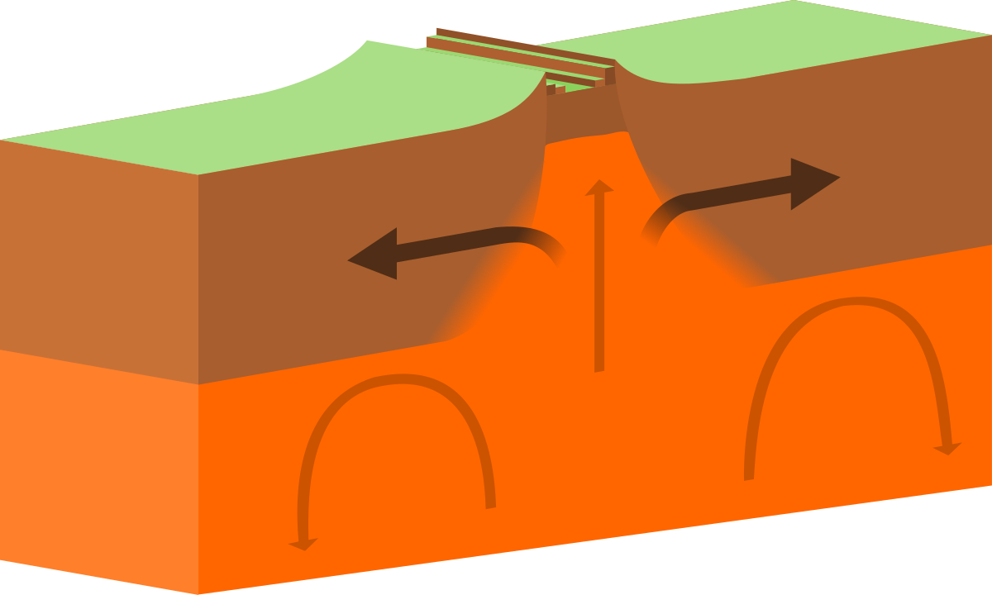

Slide 20
floods
A flood is an overflow of water that submerges land that is usually dry
Flooding may occur as an overflow of water from water bodies, such as a river, lake, or ocean, in which the water overtops or breaks levees, resulting in some of that water escaping its usual boundaries, or it may occur due to an accumulation of rainwater on saturated ground in an areal flood.
Floods can also occur in rivers when the flow rate exceeds the capacity of the river channel.
Heavy Rains.
Causes:
Overflowing Rivers. ...
Broken Dams. ...
Urban Drainage Basins. ...
Storm Surges and Tsunamis. ...
Channels with Steep Sides. ...
A Lack of Vegetation. ...
Melting Snow and Ice.

Slide 21
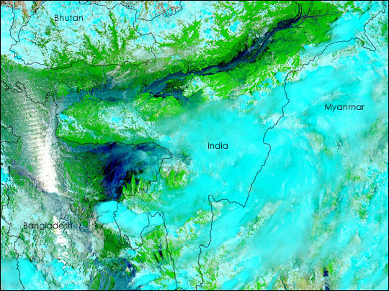
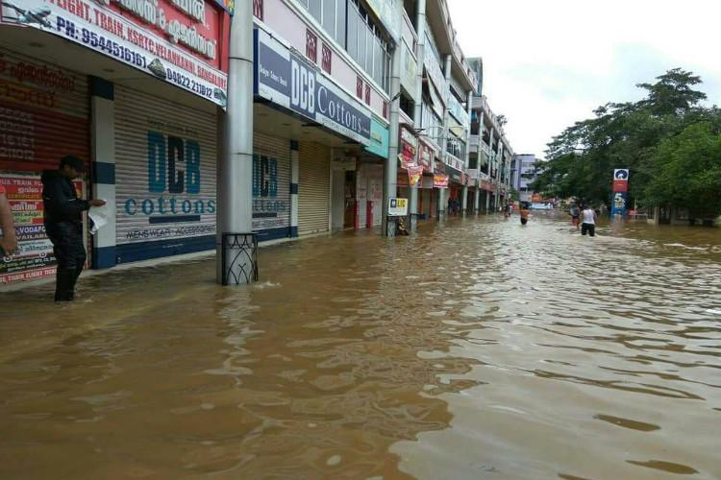
Bangladesh
Kerala

Slide 22
Cyclone
Cyclone is a rapidly rotating storm system characterized by a low pressure center, a closed low-level atmospheric circulation, strong winds, and a spiral arrangement of thunderstorms that produce heavy rain.
Cyclone, any large system of winds that circulates about a centre of low atmospheric pressure in a counterclockwise direction north of the Equator and in a clockwise direction to the south. Cyclonic winds move across nearly all regions of the Earth except the equatorial belt and are generally associated with rain or snow.
Causes:
Tropical cyclones form only over warm ocean waters near the equator.
To form a cyclone, warm, moist air over the ocean rises upward from near the surface. As this air moves up and away from the ocean surface, it leaves is less air near the surface. So basically as the warm air rises, it causes an area of lower air pressure below.
Air from surrounding areas with higher air pressure pushes in to the low pressure area. Then this new “cool” air becomes warm and moist and rises, too. and the cycle continues.
As the warmed, moist air rises and cools the water in the air forms clouds. The whole system of clouds and wind spins and grows, fed by the ocean’s heat and water evaporating from the ocean surface.
As the storm system rotates faster and faster, an eye forms in the centre. It is very calm and clear in the eye, with very low air pressure. Higher pressure air from above flows down into the eye.

Slide 23
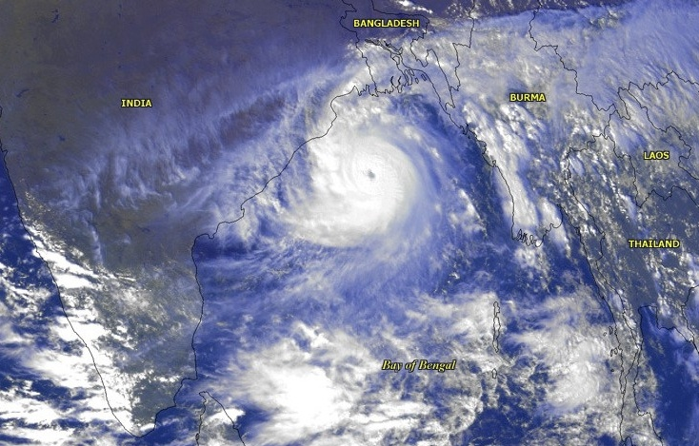
Indian Coast
Shrilanka

Slide 24
drought
The lack of adequate precipitation, either rain or snow, can cause reduced soil moisture or groundwater, diminished stream flow, crop damage, and a general water shortage. Droughts are the second-most costly weather events after hurricanes.
A drought is an event of prolonged shortages in the water supply, whether atmospheric (below-average precipitation), surface water or ground water.
Cause:
Climate changes
A drought is caused by drier than normal conditions that can eventually lead to water supply problems. Really hot temperatures can make a drought worse by causing moisture to evaporate from the soil. Just because a region is hot and dry doesn't necessarily mean it is going through a drought. Droughts only occur when an area is abnormally dry. Here's why:
Rain and snow don’t fall evenly across Earth. Some regions are routinely wet and others are routinely dry. From season to season — and from year to year — the amount of rain or snow in a location can vary.
https://www.nationalgeographic.org/encyclopedia/drought/
Wikipedia.com

Slide 25
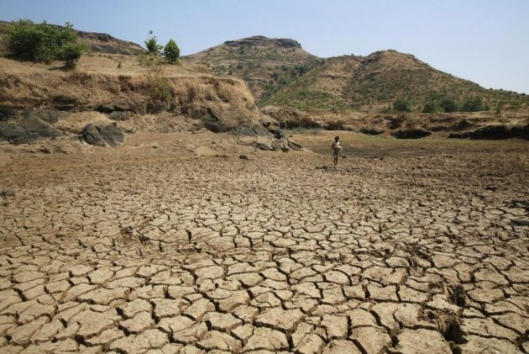
Somalia
Maharashtra

Slide 26
avalanches
An avalanche is a rapid flow of snow down a hill or mountainside.
Avalanches come in many shapes and sizes. Many are small slides of powdery snow that move as a formless mass down slope.
Causes
The load on the snowpack may be only due to gravity, in which case failure may result either from weakening in the snowpack or increased load due to precipitation.
Avalanches can also be triggered by other loading conditions such as human or biologically related activities.
Seismic activity (activities in the earth's crust relating to plate movements) may also trigger the failure in the snowpack and avalanches.
Most avalanches occur spontaneously during storms under increased load due to snowfall and/or erosion. The second largest cause of natural avalanches is metamorphic changes in the snowpack such as melting due to solar radiation. Other natural causes include rain, earthquakes, rock fall and icefall. Artificial triggers of avalanches include skiers, snowmobiles, and controlled explosive work. Contrary to popular belief, avalanches are not triggered by loud sound; the pressure from sound is orders of magnitude too small to trigger an avalanche.
https://www.nationalgeographic.com/environment/natural-disasters/avalanches/

Slide 27
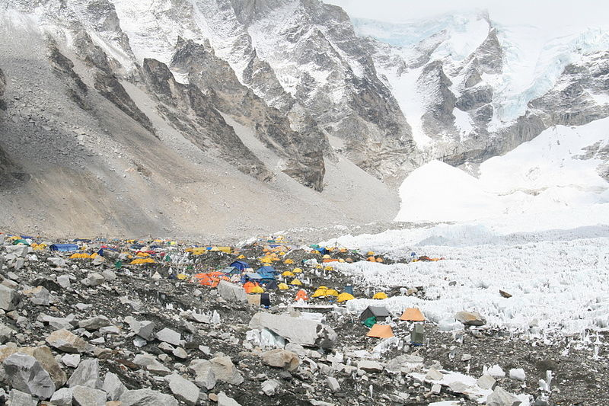
Mount Everest
Kathmandu, Nepal

Slide 28
landslides
A landslide is defined as the movement of a mass of rock, debris, or earth down a slope under the direct influence of gravity.
The term "landslide" includes five modes of slope movement: falls, topples, slides, spreads, and flows.
Slope movement occurs when forces acting down-slope (mainly due to gravity) exceed the strength of the earth materials that compose the slope. Causes include factors that increase the effects of down-slope forces and factors that contribute to low or reduced strength.
Causes:
Landslides can be initiated in slopes already on the verge of movement by rainfall, snowmelt, changes in water level, stream erosion, changes in ground water, earthquakes, volcanic activity, disturbance by human activities, or any combination of these factors.
Earthquake shaking and other factors can also induce landslides underwater.
https://www.usgs.gov/faqs/what-a-landslide-and-what-causes-one?qt-news_science_products=0#qt-news_science_products

Slide 29
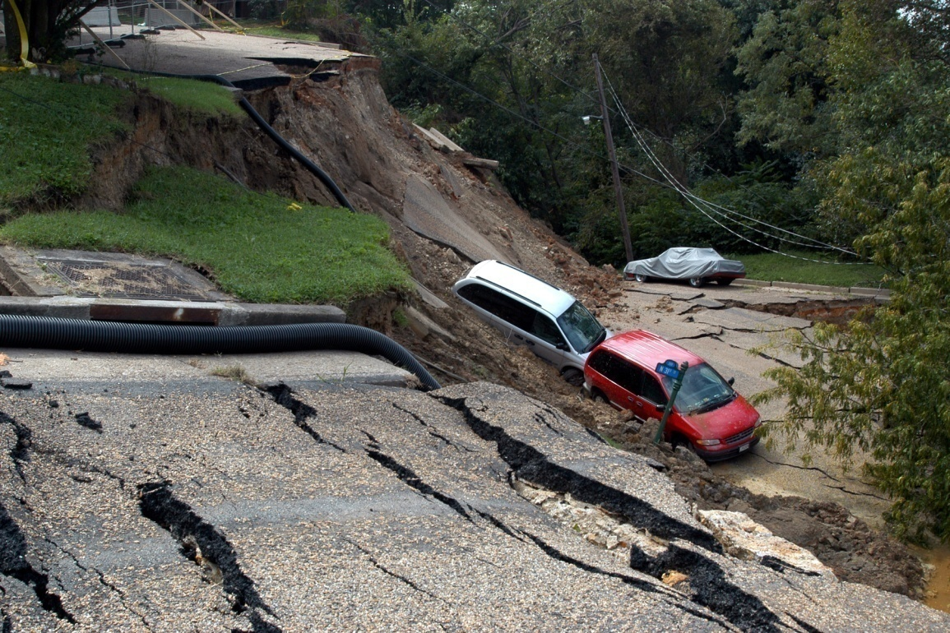
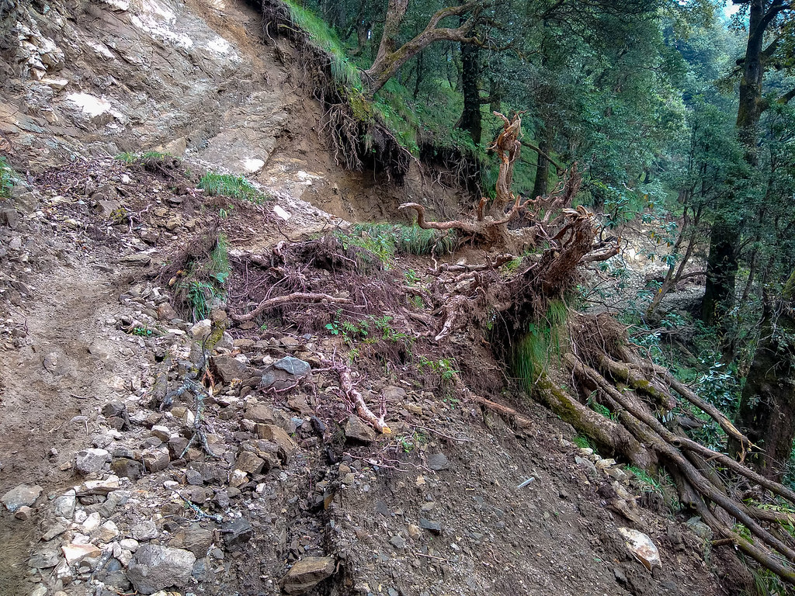

Slide 30
Man made disasters

Slide 31
Nuclear accidents
Serious nuclear power plant accidents include the Fukushima Daiichi nuclear disaster (2011), Japan and the Chernobyl disaster (1986), Northern Ukraine.
As of 2014, there have been more than 100 serious nuclear accidents and incidents from the use of nuclear power. Fifty-seven accidents or severe incidents have occurred since the Chernobyl disaster, and about 60% of all nuclear-related accidents/severe incidents have occurred in the USA.
Causes:
Nuclear power plants generate electricity by heating fluid via a nuclear reaction to run a generator. ... A core damage accident is caused by the loss of sufficient cooling for the nuclear fuel within the reactor core.
Chernobyl= The accident, which occurred at reactor 4 of the plant in the early morning of April 26, 1986, resulted when operators took action in violation of the plant’s procedures. Operators ran the plant at very low power, without adequate safety precautions and without properly coordinating or communicating the procedure with safety personnel.
These factors all contributed to an uncontrollable power surge that led to Chernobyl 4’s destruction. The power surge caused a sudden increase in heat, which ruptured some of the pressure tubes containing fuel.
https://en.wikipedia.org/wiki/Nuclear_and_radiation_accidents_and_incidents

Slide 32
The hot fuel particles reacted with water and caused a steam explosion, which lifted the 1,000-metric-ton cover off the top of the reactor, rupturing the rest of the 1,660 pressure tubes, causing a second explosion and exposing the reactor core to the environment. The fire burned for 10 days, releasing a large amount of radiation into the atmosphere.
Fukushima Daiichi nuclear disaster (2011) -The 9.0 MW earthquake occurred the largest island of Japan.
On detecting the earthquake, the active reactors automatically shut down their fission reactions. Because of the reactor trips and other grid problems, the electricity supply failed, and the reactors' emergency diesel generators automatically started. Critically, they were powering the pumps that circulated coolant through the reactors' cores.
The earthquake generated a 14 m high tsunami that swept over the plant's seawall and flooded the plant's lower grounds around the Units 1–4 reactor buildings with sea water, filling the basements and knocking out the emergency generators.
The resultant accidents led to three nuclear meltdowns, three hydrogen explosions, and the release of radioactive contaminants in Units 1, 2 and 3 between 12 and 15 March. Reactor 4 increased in temperature on 15 March due to decay heat from newly added spent fuel rods but did not boil down sufficiently to expose the fuel.

Slide 33
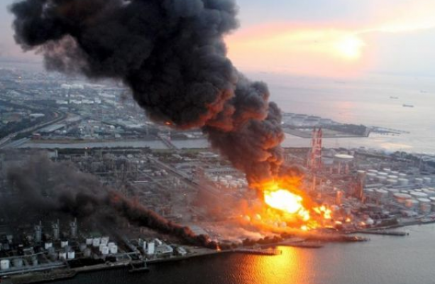
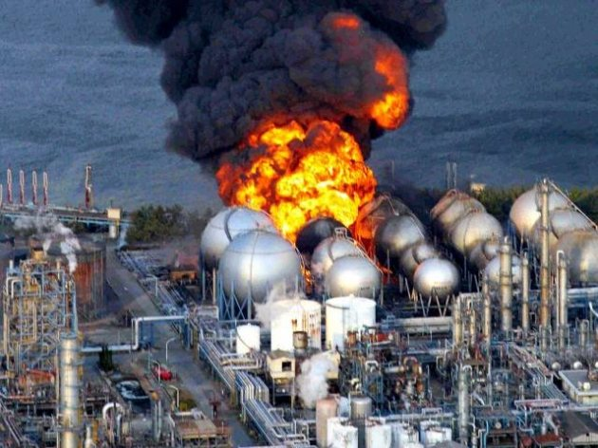
Chernobyl
Fukushima Daiichi

Slide 34
Chemical Accidents
A chemical disaster is the unintentional release of one or more hazardous substances which could harm human health and the environment. Chemical hazards are systems where chemical accidents could occur under certain circumstances. Such events include fires, explosions, leakages or release of toxic or hazardous material that can cause people illness, injury, or disability.
Causes:
Chemical accidents may occur whenever toxic materials are stored, transported or used,
The most severe are industrial accidents, involving major chemical manufacturing and storage facilities.
The most dangerous chemical accident in recorded in history was the 1984 Bhopal gas Tragedy in India, in which more than 3,000 people had died after a highly toxic vapor.

Slide 35
Bhopal gas disaster
The Bhopal disaster, also referred to as the Bhopal gas tragedy. It has occurred in Bhopal, Madhya Pradesh on the night of 2–3 December 1984.
There was a gas leak incident on the night of 2–3 December 1984 at the Union Carbide India Limited (UCIL) pesticide plant in Bhopal.
It is considered among world’s worst industrial disaster.
Over 500,000 people were exposed to methyl isocyanate gas. The highly toxic substance made its way into and around the small towns located near the plant.
Estimates vary on the death toll. The official immediate death toll was 2,259. In 2008, the Government of Madhya Pradesh had paid compensation to the family members of 3,787 victims killed in the gas release, and to 574,366 injured victims.
A mixture of poisonous gases flooded the city, causing great panic as people woke up with a burning sensation in their lungs. Thousands died immediately from the effects of the gas.

Slide 36
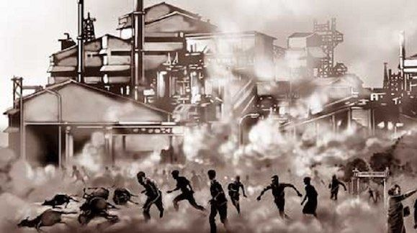
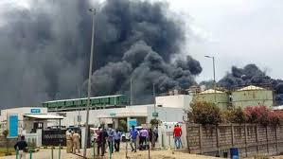
Bhopal
Gujarat

Slide 37
Hybrid disasters

Slide 38
Flood due to man made activities
In natural systems, floods play an important role in ecosystem functioning, such as by recharging groundwater systems, filling wetlands, and the promotion of breeding, migration, and dispersal of numerous species.
Causes:
Infrastructure failures
Floods can be caused by a breaking or failure of infrastructure that can cause large quantities of water to flood a local area.
One example is when water mains break such as the one that occurred in July of 2014 on the UCLA campus in the United States that caused water to gush out into the surrounding area at 75,000 gallons per minute.
Development and infrastructure in flood-prone areas
The development and building of infrastructure in flood-prone areas, such as along rivers, near ocean shorelines, or near river deltas, has led to an increase in vulnerability to flooding because the natural resiliency of these ecosystems has been compromised.
https://greentumble.com/what-are-the-human-causes-of-floods/

Slide 39
Deforestation
When deforestation occurs in a particular area, there are no more trees to soak water into the soil over the landscape. Without these natural protections, there is an increased risk of flooding and erosion whenever it rains.
Impermeable surfaces
In developed areas, such as in urban area, there is commonly a large amount of impermeable surfaces like roads and other concrete structures that do not allow water to permeate back into the soil.
Bridge constriction
Sometimes, bridges that have been built over rivers can slow the discharge of water and reduce the river’s capacity to hold more water.

Slide 40
DEALING WITH DISASTERS
Disaster management aims at minimizing or avoiding potential losses , ensuring prompt assistance to victims of disasters and recovering the losses.
It also involves reshaping of policies and plans to lessen the effects of disasters.
Management involves four stages namely prevention, mitigation, preparedness and response.
1 Prevention
It involves all those activities that are required to prevent the disaster and subsequent losses. It involves participation of all groups of society, government, non governmental organizations and other institutions.
Disaster Management Action Plan (DMAP):
This plan is operated by various departments and agencies of the government of Maharashtra and other Non Governmental agencies. There are plans for institutions also . The purpose of these plans is to assess status of available resources and facilities available with the various departments., to identify requirements of technological support, up gradation of information systems.
It is the responsibility of state to be ready with DMAP in all the emergency situations. It is also associated with disasters like road accidents, fires, earthquakes, floods, cyclones, epidemics and other industrial accidents.
The disaster management plan of the state focuses on the role of various governmental departments and various agencies like “ emergency Operations Centre” for the immediate response during disasters.

Slide 41
Warning system:
Arrangement of early warning system provides advance notice to all citizens. It helps people to safeguard their family, property. It indicates onset of a disaster. Warning system may range from alarms, sirens, public announcements through radio, television etc. Some traditional modes are ringing bells, hoisting of flags. Warnings should be clear about severity, the duration.
It should be in a simple language which is understandable by local people. It should not create panic behavior. Warning should be clearly given so that it will clear the severity, the duration and the areas that may be affected. Spread of rumors should be controlled.
All the agencies and organizations should be alerted.
Subsequent warnings should be given to keep people informed of the latest situations.
All clear signal should be given when disaster will recede.
Education and training:
People should be educated regarding disaster management.
Various educational institutions, corporate sectors and NGOs should arrange training and awareness programmes.
Various training and awareness programme should be arranged for long term prevention and preparedness .

Slide 42
Dealing with earthquake
Measures against earthquakes
Personal measures
Seek shelter under stable tables or under door frames.
If outside, stay away from buildings, bridges and electricity pylons and move to open areas.
Avoid areas at risk from secondary processes, such as landslides, rockfall and soil liquefaction.
After an earthquake, check gas, water and electricity pipes and lines for damage.
Listen to the radio and follow the instructions issued by the authorities.
Earthquake-proof planning and design of buildings
The micro zoning of the local geological substratum provides indicators of areas in which tremors will have a particularly strong or attenuated effect.
Organizational measures
At present, earthquake prediction is insufficiently precise to provide the public with sufficient advance warning. For this reason, adequate preparedness and assistance in catastrophes is extremely important in areas affected by earthquakes. Measures of this nature enable numbers of human lives to be saved.
http://www.planat.ch/en/knowledge-base/earthquake/measures-eb/

Slide 43
2.Mitigation
Mitigation is an attempt to prevent hazards from developing into disasters. It reduces the impact of disasters so reduce loss of life and property. It focuses on long term measures for eliminating risk.
Risk analysis needs to be conducted which provides foundation for mitigation activities. Eg. Insurance can be obtained to protect financial losses.
Structural measures may include the changes in the structure of building or surroundings.
Non structural measures may include legislations or regulations regarding evacuation, communication of risk to the public etc. It may also include obtaining property or building insurance etc.
Basic objectives of disaster mitigation are:
To reduce loss of life and property by mitigating the impact of disaster
The authorities and agencies need to advise the public about health and safety precautions to protect against injury and loss of life.
Guidance should be given by central and state authorities to local authorities regarding services available in critical situations.
There is a need to maximize insurance coverage to provide financial protection against hazards.
Public should be made aware and need to be educated on actions they should take to reduce the loss of life or property from hazards.

Slide 44
There should be a proper communication and coordination within and among the Central, State and local authorities in carrying out mitigation.
There is a need to promote adequate staffing , training for carrying out hazard mitigation.
The authorities need to provide relief camps in the case of major disasters. Provision for intermediate shelters need to be made within the period of disaster.
Provision for compensation for crop and livestock is to be made.
A long term package of mitigation includes a special package for reconstruction work to rehabilitate the damaged infrastructure by central and state government.
Relief and Rehabilitation Measures:
Government , NGOs and others should undertake various relief and rehabilitation measures.
Relief camps should be installed during major disasters such as earthquake or floods.
Compensation for crop and livestock loss is given. It is also given for dead or missing persons.
Special relief ration need to be provided to the affected people.
Drinking water facility need to be provided specially in the case of disasters of floods , cyclones when drinking water source is polluted.
Preventive measures need to be taken to prevent any outbreak of communicable disease.
Health centres to be made functional at the earliest to provide medical care and treatment.
Free medicines need to be supplied to those who are injured,
Central and state government come up with long term measures for reconstruction of permanent houses and community infrastructure such as community centres, religious structures etc.

Slide 45
.
Restoring the livelihood of many people with provision of micro units, processing and marketing facilities.
Reclamation of land affected by salinity or flooding is also a rehabilitation measure.
Reconstruction of local transport facilities such as jetties, railway stations etc. which are damaged by the disaster is an urgent need which is provided by the local government.
Restoration of damaged power and information communication technology infrastructure is essential.
Upgrading drinking water supply and drainage system is essential.
Construction of social infrastructure such as schools, primary health centers etc. is essential

Slide 46
flood
Structural and non-structural flood mitigation measures
It is important to understand the effectiveness of individual measures in terms of flood mitigation impact when considering structural solutions for flood mitigation.
Depending on locality and the nature of the flooding, a number of structural and non-structural mitigation measures may be available. However, flood mitigation measures may only lessen the impact of flooding. No amount of intervention can stop heavy rain or high tides.
Structural flood mitigation
Structural flood mitigation is where physical structures are constructed or modified to reduce the impact of flooding on individual properties or whole catchments and include:
Infrastructure, including dams, levees, bridges and culverts
Maintenance of existing infrastructure
Ongoing maintenance to existing creeks and storm water drainage systems is vital to maintain the hydraulic performance of drains.
Developing and reviewing a regular maintenance schedule for flood prone areas can provide significant benefit during seasonal rains.

Slide 47
Individual flood proofing measures
Where the inundation of flood water is relatively low (nominally less than 700mm), it may be possible to keep flood waters out of homes by installing solid fences, raising windows, sealing doors with ‘stop boards’ and limiting sewage contamination through reflux or backflow valves.
Improved traffic access
Improving the flood resilience of roads provides a benefit to flood-affected residents by allowing residents to escape floods. Hospitals and emergency services should have such provisions.
Non-structural flood mitigation
Property surveys and Land use planning
Detailed surveys of flood affected residences can increase the accuracy of flood modeling.
Strategic land use planning will identify the extent of flood impacted land to limit the construction of urban and rural residential, commercial and industrial land. The NT Planning Scheme requires all new developments to undertake land suitability investigations to determine the extent of constrained land.
Existing building controls require new homes or substantial renovations to construct habitable floor levels to provide some level of protection from flooding.

Slide 48
Catchment flood modeling
Maintaining up-to-date flood models of developing catchments assists the Development Consent Authority to understand the impact of new development on existing residents in the catchment.
Early warning systems
Early warning systems are extremely important in flash flooding events to provide residents with the ability to respond to impending flood waters. This may include relocating of parked vehicles, collecting pets and valuables and implementing personal emergency plans.
Understanding and awareness
Knowing your local flood history and developing an understanding of how floods behave in your area provides you with the ability to respond in time to an impending flood. Monitoring tide and rainfall forecasts can alert residents when the conditions that may result in flooding could occur.
https://dipl.nt.gov.au/lands-and-planning/flood-mitigation/flood-mitigation-measures

Slide 49
3. Disaster Preparedness
Preparedness is a plan of action developed to deal with the situation when the disaster strikes.
It involves measures designed to organize and facilitate timely and effective rescue, relief and rehabilitation operations in case of disaster. It involves setting up of disaster relief machinery, formulation of emergency relief plans, training of people, stocking of supplies, fund raising etc.
Following activities are done under preparedness:
Communication Plans:- Proper communication plays very important role in disaster management. If communication plans are properly organized , it not only warns the people about threat of disasters but also carry out relief and rehabilitation operations. Clear instructions will undertake all the operations smoothly.
Training: Training should be provided for disaster preparedness. The government develop organizations of trained volunteers among civilian population. Organizations like Red Cross are ready sources of trained volunteers.
Casualty Prediction: Causality prediction is an important aspect in disaster preparedness. It studies the expected casualties which gives planners an idea of what resources should be made available to respond to a particular kind of event.
Stockpiling: Stockpiling of food supplies and maintaining other equipments becomes essential. Maintenance of other equipments is also essential. A three day supply of food and water is a minimum recommendation. Some essentials for children can be stored.

Slide 50
Evacuation: Disasters may require evacuation of communities. All agencies involved in
evacuation must play a role to avoid confusion and panic. Evacuation must be ordered only by the government authorities such as Collector, Police or Fire Brigade. Proper security and law should be maintained with assistance from community leaders. All evacuations should be reported to Collector or District Superintendent of Police immediately.
During evacuation
Shelters should be within an hour’s walk.
Routes should be away from the coast or flood prone areas, may include pathways.
Families should be encouraged to take along water , food, clothing and emergency supplies to last at least for three days.
People should listen to battery powered radio and follow local instructions
In the case of chemical release, the people should be instructed to evacuate immediately.
Evacuation should be carried out as soon as possible in the case of marooned people. If its not done within 3 hours, marooned people must be provided with water, medicines, first aid and cooked food.
Emergency transport can be arranged for seriously injured people through speed boats or helicopters. Medical kits are carried with medical officers. Immediate medical attention is given to seriously injured people.

Slide 51
Preparedness for earthquake
Prepare for three to seven days of electricity, water, gas, and telephone outages.
Keep an earthquake kit on hand, including a well-stocked first aid kit a supply of medicines required for life-threatening conditions, copies of important documents, extra money, a flashlight, a hand crank or solar-powered radio, extra batteries, blankets, drinking water and nonperishable food, and tools to shut off utilities. Store the kit in a secure, waterproof location that is easily accessible.
Conduct calm family discussions about earthquakes. Decide upon an outdoor meeting location for your family to reunite after a quake and conduct in-home practice drills. Teach your household members to knock three times repeatedly if they were to become trapped inside your home.
Conduct a thorough investigation of your home, checking for any defective wiring, leaky gas connections, and deep cracks in the ceiling or foundation that could pose a danger during a quake.
Install flexible, corrugated pipe fittings to avoid gas and water leaks. Flexible fittings are more resistant to breakage. If recommended by your gas service provider, have an automatic gas shutoff installed that can be triggered by strong vibrations.
Learn how to shut off all utilities in your home.

Slide 52
Use bolts or straps to secure heavy items that may topple over, such as a bookcase, china cabinet, or water heater. Store heavy, hazardous, or flammable materials on low shelves or in secure cabinets. If you are a renter, ask your landlord to secure furniture and water heaters to the wall.
Avoid placing heavy objects, such as shelves and picture frames, on walls where they could fall onto a bed or locations where your family would be sitting. Hang objects from closed hooks and secure corners with earthquake putty.
Secure cabinet doors with latches to prevent items from falling out during an earthquake.

Slide 53
4. Response phase
It includes the mobilization of the necessary emergency services.
It includes events like setting up control rooms, putting the contingency plan in action , issue warning action, taking people to safer shelters, providing medical aid to the injured, etc.
This phase reduces impact of disasters on life, property of the society by setting control room, evacuation of people.
This step ensures that measures are being taken to alleviate and minimize the loss of life and property.

Slide 54
Response during earthquake
Drop to the floor, get under a sturdy table, and hold on until the shaking stops. If your entire body does not fit underneath the furniture, position your body so that at least your head and neck are covered.
If indoors, stay there; most injuries occur when people inside try to move to a different location or try to leave. Avoid windows, exterior walls, stairwells, elevators, and objects that could fall. Be aware that the electricity may go out and the fire alarm or sprinkler system may turn on.
If outside, get into an open area. Stay clear of buildings, power lines, streetlights, and anything that can fall on you.
If driving, move out of traffic as quickly as possible and shut off the engine. Avoid bridges and overpasses, and anything that could fall onto your car, such as trees, light posts, powerlines, and signs.
If in bed, stay there. Hold on and protect your head with a pillow. Only move to a nearby safe place if you are under a heavy light fixture or something that may fall on you.
If in a wheelchair, stay in it. Move to a safe location, lock your wheels, and cover your head and neck.

Slide 55
Assam floods
A team of National Disaster Response Force (NDRF) carried out rescue operation in flood-affected areas of Barpeta District.
The team rescued several people and took them to safe places.
The NDRF team also checked the temperature of the people.
Intense rainfall over the past three days has led to the Brahmaputra and its tributaries to flow above danger level in different parts of the state.

Slide 56
5. Recovery phase
This phase restores the affected area to its previous state.
Efforts are done to recover all the areas after the disaster.
It includes actions that involve disaster assessment, damage clearance, immediate rehabilitation, reconstruction planning and implementation.
Counseling and providing social support to disaster survivors is an important element.
Short term recovery activities aim to return life supporting systems ( such as shelter, water, clothing, medicines etc) to operating status.
Long term recovery activities take several months or years to return life to its previous stage. It may include provision of financial assistance for redevelopment, legal assistance, community development, psychological assistance etc.

Slide 57
Go to your predetermined outdoor meeting location. Check for injuries to others and provide assistance as needed.
Check for and extinguish small fires. Clean up any spilled flammable liquids immediately.
If you smell gas or hear a hissing sound, open a window and quickly leave the building. Shut off the main gas valve only if you suspect a gas leak. Return home only when it is declared safe. Once gas lines are turned off, service should be restored only by your service provider.
Check appliances and electric lines for damage. Unplug any damaged appliances or light fixtures, and shut off power at the main fuse box if there are sparks, frayed wires, or if you smell something burning.
Check for sewage and water line damage. If you suspect damage, avoid using the toilet until you call a plumber.
Watch out for items that may have shifted in cabinets or closets that can cause further damage or injury upon opening the doors.
If you are trapped under debris, do not light a match or move about. Cover your mouth with clothing and tap on a pipe or wall so rescuers can locate you. Only shout as a last resort, as it can cause you to inhale dangerous amounts of dust.
If you are driving, watch out for road hazards, including fallen trees, power lines, and damaged bridges and roads. If a power line fell onto your car during the earthquake, stay inside until trained personnel remove the wire.

Slide 58
Use the telephone only for emergencies. 911 systems will be overloaded after an earthquake. Keep the phone lines clear for emergency calls to get through.
Listen to the radio for important information.
Inspect your home for signs of structural damage, particularly to the foundation and chimney. Damage to these areas can pose serious safety hazards in the months after an earthquake. Do not enter a structurally compromised structure. Call a certified home inspector if you are unsure of your home’s structural stability.
Be prepared for aftershocks! Aftershocks can occur minutes, days, or months after an earthquake. Drop, Cover, and Hold on each time shaking occurs

Slide 59
Recovery after drought
1. Understand how drought has affected forages, livestock and finances
Range condition influences the rate of recovery in forage production after drought. Animal performance may be diminished, and herd size may be reduced. The financial balance sheet as well as cash flow may be impacted for five years or more. This understanding will form your strategies for recovery from drought.
2. Take inventory
3. Identify and evaluate strategies to help you recover from drought
Identify strategies for recovery, and evaluate the impact that those strategies will have on your cash flow, pasture health, livestock herd, and family.
4. Learn to monitor drought, forage resources, livestock health, and finances
Recent droughts have taught ranchers about the need for long-term monitoring of the weather, and their livestock, vegetation, and financial resources. Monitoring should begin in advance of drought, so that you have the information you need to make fast and effective decisions near the beginning of drought and before prolonged drought cripples your plan, animal, and financial resources.

Slide 60
5. Start planning to get forage, livestock and finances for the next drought.
https://drought.unl.edu/ranchplan/AfterDrought/StartHereAfterDrought.aspx

Slide 61
For Earthquake & tsunami
A) Risk reduction measures
Hazard mapping
Public awareness and training
Land use control or zoning building codes
Insurance
B) Preparedness measures
Earthquake warning
Preparedness programme
Training to NGO and Govt. officials for rescue operations
Fixing instruments like Deep Ocean Assessment and Reporting Tsunami
C) Post disaster needs
Search and rescue
Distribution of food and drinking water
Emergency medical assistance
Survey on damaged needs
Relief assistance
Reconstruction and rehabilitation

Slide 62
For volcanoes
A) Risk reduction measures
Land use planning
Protective structural measures
B) Preparedness measures
National volcanic emergency plans
Volcano monitoring and warning systems
Training to NGO and Govt. officials for rescue operations and fire fighting
C) Post disaster needs
Ground and aerial survey to assess damage
Evacuation plan
Emergency response
Reconstruction and rehabilitation

Slide 63
For floods
A) Risk reduction measures
To control flood construction of channels, dykes, dams etc.
B) Preparedness measures
Detection of flood and warning systems
Community participation
Development of plan for flood plain management.
C) Post disaster needs
Search and rescue operations
Supply of food and drinking water
Water purification
Temporary shelter
Arrange vaccination programmes to control diseases

Slide 64
For droughts
A) Risk reduction measures
Early warning
B) Preparedness measures
Development of drought response plan plan.
C) Post disaster needs
Measures for food security
Employment creation programme
Proper food distribution system
Special programme for livestock
Supplementary feeding programme
Rehabilitation and health programme

Slide 65
For cyclones
A) Pre disaster measures
Planting wind breaker trees along the coast
Construction of embankments along the coast.
Construction of proper drainage system.
Construction of roads for quick evacuation.
Development of radio/siren system
Mapping
Public awareness and training
C) Post disaster needs
Search and rescue operations
Emergency medical response
Survey on damage and needs
Provide temporary shelter
Arrange for short term food and water supply.

Slide 66
For avalanches
A) Risk reduction measures
Snow fences, light walls
Dense trees can be planted.
B) Mitigation measures
Development of artificial barriers.
Snow Net- strung between poles anchored by wires.
Snow fence- Rigid fence and constructed of steel, wood or concrete..
Avalanche dam- Barriers made up of concrete, rocks or earth.
Earth Mounds: To slow avalanches down.
Safety measures are
Terrain management
Group management
Control measures

Slide 67
Nuclear accidents
A) Risk reduction measures
Preparedness for emergency
Community awareness
B) Preparedness measures
Hazard mapping
Inspection of storage
Improving fire fighting facilities
Monitoring pollution levels
Practicing evacuation plans
Testing warning system
C) Post disaster needs
Search and rescue operations
Clean up programmes
Alternate drinking water source
Monitoring environmental effects
Evacuation from affected area

Slide 68
Chemical industry
A) Risk reduction measures
Analyze the chemicals used in different workplace, identify their potential hazards.
Workplaces should not be crowded to avoid biological hazards.
Shower facility should be available
Worker counseling programme
Workplace should have locker room to change clothes.
C) Post disaster needs
Enclose the source of hazard.
Isolate the object
Substitute with other chemicals
Production process must be assessed for risk.

Slide 69
Human rights issues in addressing disasters
There are several instances in India and other developing countries, where human rights violations occur even at the time of disaster.
Some of the violations relating to compensation and distribution of relief are as follows:
Discrimination in Relief distribution: Caste based discrimination occurs during disasters at the time of distribution of food and other aids
Gender discrimination
Economic class based discrimination.
Lack of concern for Children
Atrocities of Backward castes
Neglect of Women Rights
Lack of information
Harassment to Victims to claim compensation

